Slide 1
IT Basics
2019
Bus Basics B1

Slide 2
General

Slide 3




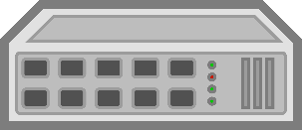

What is a network
A network consists of two to several million devices
Sharing resources (printers, memory, etc.)
Services (communication, IoT, etc.)
Internet is the largest existing network and is a network of private and public networks
Notes:
Networks exist in all sorts of sizes. They range from simple networks consisting of two computers to networks consisting of millions of devices.Simple home networks allow resources such as printers, documents, pictures, and music to be shared between multiple local computers.In companies and large organizations, on the other hand, networks can be used to an even greater extent to enable consolidation, storage and access to/from information through a server in the network. Networks also enable fast communication, such as e-mail or chat, and generally collaboration among employees. In addition to the internal advantages, many companies use their networks to offer their customers products and services via the Internet.The Internet is the largest existing network. In fact, the term "Internet" stands for a "network of networks". The Internet is literally a collection of interconnected private and public networks.The figure above shows a company on the left that has several servers and computers. On the right side you can see a home network as probably almost everyone has at home nowadays. In the following, the network infrastructures, the individual devices and their functions are described in more detail.

Slide 4

Network infrastructures
Long distances
LAN spanning
Mostly managed by ISPs
WAN (Wide Area Network)
Internet Service Provider (ISP)
local networks (home network, company network, etc.)
LAN
LAN
LAN (Local Area Network)
short distances
e.g. home network, company network; often managed locally
Notes:
The basis for effective communication between two or more computers is a functioning network infrastructure. Networks are often differentiated by their spatial extent.LAN:A Local Area Network (LAN) is a network infrastructure that makes it possible to access data and terminals over short distances. As a rule, a home network or part of the corporate network is referred to as a LAN. A LAN is often managed by the owner of the house or apartment or by the IT department of the company itself. Certain companies that do not have their own IT department have their LAN or their entire network managed by an IT service company.WAN:A Wide Area Network (WAN) is a network infrastructure that, for example, enables a user to access systems across LANs. It is important to understand that a WAN is the higher-level network that connects multiple LANs. A WAN often extends over long distances or even entire continents. Since many companies do not have the size or the financial means to operate such a large network themselves, they often purchase their WAN as a service from a service provider that already operates an entire network infrastructure of this size. Usually, a WAN is configured in such a way that only companies with their own employees and systems can transmit data over this network.

Slide 5
Network Addresses
Network addresses serve as unique identifiers in the network
Each device in the network has two different addresses
Physical address -> MAC address
Logical address -> IP address
Link between IP and MAC address (ARP)
Notes:
A network address is an identifier for a device in a network. Network addresses serve as unique identifiers throughout the network, although some networks allow local, private, or even locally managed addresses that may not be unique. Each network device has two different types of addresses. One is the physical address, which is also known as the MAC address, and the other is the logical address, which in most cases is the IP address.

Slide 6
MAC-Address
Unique identification
Is allocated by Manufacture of Internet-enabled devices
The MAC address can be used to identify some of the manufacturers.
Address is 48 bit long
Example: 00-16-21-25-AF-D7
Notes:
In order to be able to identify a computer uniquely, there is the so-called MAC address. MAC addresses are assigned by the manufacturer of an Ethernet network card or an Ethernet-capable device. The address of each interface is theoretically unique worldwide, like a kind of fixed serial number. MAC addresses are 48 bits (6 bytes) long. This makes a total of 248 addresses possible. To make the representation compact and easy to read, MAC addresses are normally written in hexadecimal notation and the individual bytes are separated from each other by hyphens or colons. An example of this notation is: 00-16-21-25-AF-D7. The MAC address can also provide information about the manufacturer of a hardware, since each manufacturer is assigned specific MAC addresses. For example, the initial digit sequence "00-07-E9" stands for Intel, "00-60-2F" for Cisco and "00-15-F2" for Asus. Each MAC address should be permanently assigned to a network device and be unique. However, it is usually also possible to change MAC addresses by software.
The MAC address works on the Data Link Layer of the OSI model. The MAC address is linked to an IP address on the network layer. With the Address Resolution Protocol (ARP), the MAC address belonging to an IP address can be found out. The searching computer sends an ARP request to its network, in which it asks what the MAC address of the computer with a certain IP address is. If the computer with the correct IP address receives this ARP request, it answers the other computer with its MAC address.

Slide 7
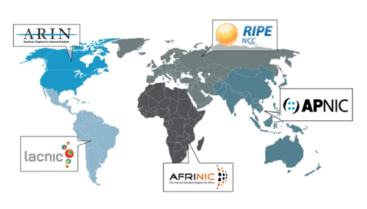
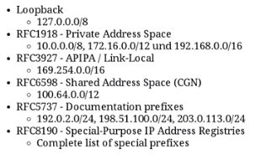
IP-Address (IPv4)
Internet Protocol
Temporary identification in networks
Public (global) & private IP addresses
Public IP addresses
are administered/allocated by IANA (Internet Assigned Numbers Authority).
are unique worldwide
are directly accessible on the Internet
Private IP addresses
are mostly managed/assigned locally
Adresse ist 32 Bit lang
Example: 192.168.0.10
Notes:
The commonly used version of the Internet Protocol (IP) is version 4 (IPv4), which has not changed significantly since its release in 1981. IPv4 is robust, easy to implement and interoperable. IPv4 addresses are 32 bits (4 bytes) long, so a total of 232 addresses are possible. The representation in the so-called dotted decimal notation is common, such as: 192.168.1.100
An IP address is a unique numeric value used to temporarily identify a computer on a network. If the computer leaves this network and, for example, is connected to another network, the old IP address is released for the next computer and an IP address is assigned to the IP range of the new network instead. This is necessary because the computer with an old IP address from another IP range in the new network could not communicate with the other computers. There are two types of IP addresses: public (also known as globally unique IP addresses) and private.
The public IP addresses are used exclusively on the Internet and administered by the IANA (Internet Assigned Numbers Authority) or the administration for Europe is delegated to RIPE (Réseaux IP Européens). The addresses are guaranteed to be unique worldwide and accessible on the Internet. This ensures that several computers do not have the same IP address. An Internet Service Provider (ISP), such as Verizon, receives a range of public IP addresses from IANA. The ISP then assigns the addresses to the customer, which it should use when connecting to the Internet via the ISP.
The private IP addresses are reserved for the intranet or local network. Its operator (e.g. the IT department of the company) is itself responsible for the address administration.

Slide 8
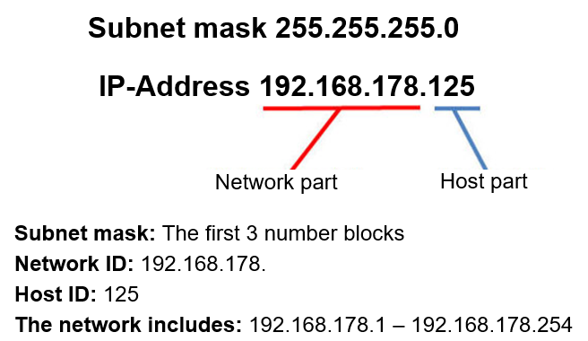
IP address structure (IPv4)
Dotted Decimal Notation x.x.x.x
Each octet (x) has 8 bits -> range 0-255
IP address is divided into a net ID and a host ID using the subnet mask
Example:
Binary system:
https://www.youtube.com/watch?v=LpuPe81bc2w&t=252s (1’50’’)
Notes:
IP addresses consist of 4 number blocks, e.g. 192.168.178.1 (decimal notation). Each number block can be within the range 0 to 255. An IP address such as 192.168.178.469 therefore does not exist, because the numeric keypad 469 would be outside this range. The reason for this is that with IP addressing in the IPv4 version, each numeric keypad occupies 8 bits. 8 bits are 1 byte and therefore 256 different numbers can be represented. Since the 0 is counted, the allowed range is from 0 to 255.

Slide 9
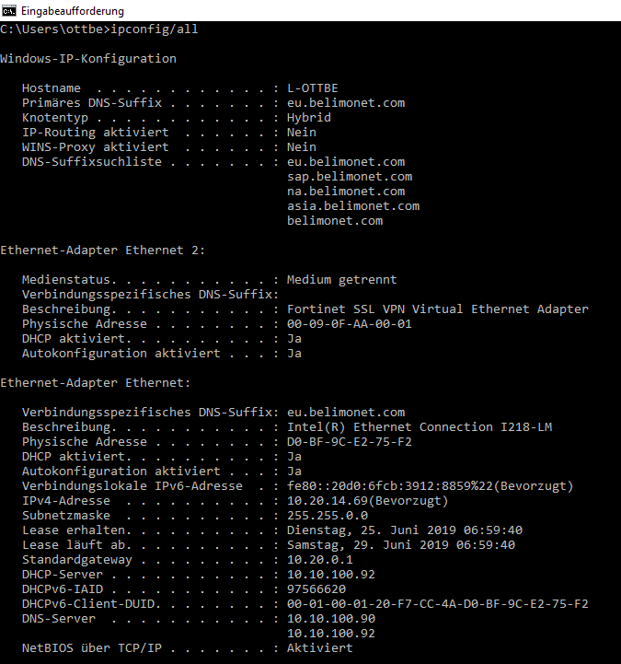
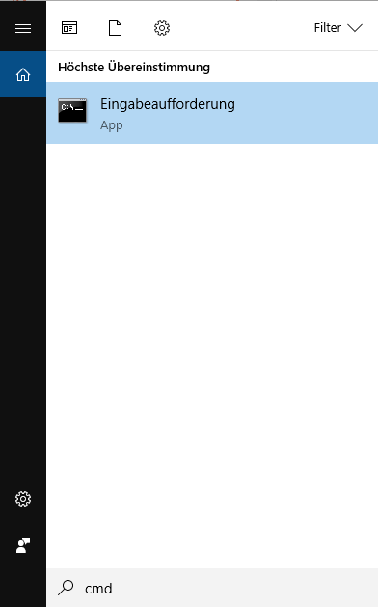
MAC-, IP-Adresse & Subnet mask
Check your IP Settings
-> ipconfig /all

Slide 10
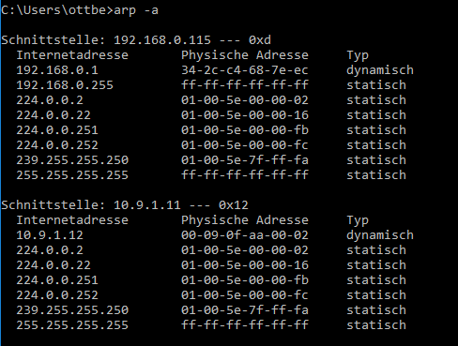
MAC-, IP-Adresse & Subnet mask
Check you ARP list
-> arp -a

Slide 11
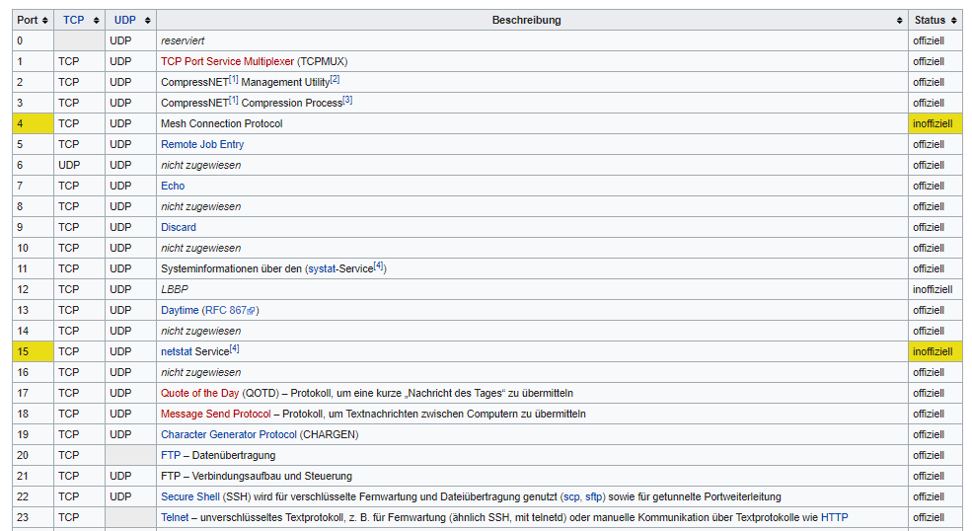
Port
Ports are part of every IP communication
Valid port numbers are 0...65'535
System Ports
User Ports
Dynamic Ports
Notes:
System Ports
Ports 0 to 1023
These ports are also called known ports and are reserved for services if they have not already been assigned as "reserved ports" of the IANA itself (e.g. for future extensions), which applies especially to the interval limits (e.g.: 0, 1023, 1024), which are therefore not available for use by servers. New assignments are only made with the participation of the Internet Engineering Task Force (IETF).
User Ports
Ports 1024 to 49151
These ports are intended for registered services, but can also be used for client programs. The dynamic assignment for client programs is no longer performed by the majority of current operating systems because the "Dynamic Ports" are provided for this purpose. In this area, new assignments can be made on request without the involvement of the IETF.
Dynamic Ports
Ports 49152 to 65535
These ports are dynamically assigned to client programs by the operating system.
Addition: Linux systems very often do not adhere to this standard and assign the client ports in the range between 32768 and 61000. Originally the ports 1024 and above were intended by the IANA for client programs. However, there were some discussions during the conversion of the port range until today's division prevailed. However, the change was made in Linux during the discussion period and was not implemented to the final standard. As a reason for this, it is repeatedly stated that the range of dynamic ports is too small. Some NAT routers use even lower ports
Source: wikipedia

Slide 12
Recap
MAC Adresse
IP Adresse
Netz-ID / Host-ID
Port
Useful links to recap at home:
https://www.youtube.com/watch?v=ddM9AcreVqY (14’48’’)
https://www.youtube.com/watch?v=XQ3T14SIlV4 (20’17’’)
https://www.youtube.com/watch?v=4xlzlgYGqW8&list=PLl9NdZbdtA0wK8OIgttkScKRxcMkvoev_&index=3 (10’58’’)

Slide 13
Network Components

Slide 14

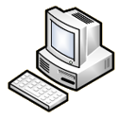



Client and Server
All end devices in the network are classified as hosts
Servers provide services (e.g. web server)
Client use services (e.g. web browser)
Webserver
Mailserver
Fileserver
Tablet
Computer
Printer
Laptop
Notes:
All computers connected to a network that are directly involved in network communication are classified as hosts. Hosts are also referred to as endpoints.
Servers are computers with software that allows them to share information, such as e-mail and Web pages, with other endpoints on the network. Each service requires different server software. For example, a server needs web server software to share web services with the network. A computer with server software can provide services to one or more computers simultaneously. In addition, a single computer can run different server software. At home or in a small business, a computer may be used as a file, web, and e-mail server.
Clients are computers that have software installed on them that can retrieve and display information received from the server. An example of client software is a web browser such as Chrome or Firefox. A single computer can also run different types of client software. For example, a user can check e-mail and access a Web page while using instant messaging and listening to Internet radio.

Slide 15
Peer to Peer
e.g. Access local Energy Valve webserver with a laptop

Slide 16
Hub (out of date)
Connects end devices to each other
Sends all incoming frames to all other devices

Slide 17
Switch
Connects end devices to each other
Forwards incoming frames to the device addressed
Manages a list with internal identifier
Data Link Layer
Notes:
The various end devices, such as computers, are connected to a switch using a network cable. The switch has several ports to which the devices can be connected with a network cable. The switch then assigns and manages an internal identifier for each port. The devices recognize each other by their individual network identifiers. They can communicate directly with each other without the other ports being aware of it. So the switch is the device that connects different devices to a network, but enables separate communication and data transfers. The best known are the so-called LAN parties. Several computers are connected to each other by a switch (or several) in order to play against and with each other in parallel. Another example are office networks in which many workstations are connected to each other.
Switches (also called Layer 2 switches) work on the Data Link Layer (see OSI Layer). They receive all incoming frames and forward them to the correct ports based on the destination MAC address. Switches ﬁltern receive the frames. This means that they only forward frames if it makes sense. They also check the frames with checksums for correctness. Since they do not actively participate in the communication, they do not need any addresses themselves for filtering and forwarding.

Slide 18

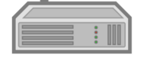
Wi-Fi Access Point
WLAN
Notes:
An access point is a device used to set up a Wireless Local Area Network (WLAN), usually in an office or larger building. An access point can normally be connected to a wired router or switch via an Ethernet cable and transmits a WLAN signal to a specific frequency range (within 2.4 Ghz or 5 GHz). Access points usually connect notebooks and other mobile devices with built-in wireless adapters to a LAN or other wired data network (telephone network, cable TV network) via a WLAN.

Slide 19


Router
Connects networks (logical network, LAN and WAN) by routing data packets to other networks
Allocates IP addresses (DHCP server)
Notes:
Large network infrastructures usually consist of several smaller networks with their own logical address ranges. Routers handle the forwarding of data packets between logical networks. Routers also make it possible to connect the local network (LAN) with a wide area network (WAN). To access other networks, the packet must be processed by a router. The router's role is to determine the best path and forward the packets to the target host. This process is called routing. A packet can pass through a variety of active network components before it reaches the target host. Any router that passes through a packet to reach the target host is called a hop.
A router therefore forwards data packets between networks with their own logical address ranges and, like switches, has several ports. The data packets forwarded from a router are called IP packets. In addition to the user data, these packets also contain the sender and destination IP addresses, as well as the associated port numbers. Each router manages a local routing table with the logical address ranges known to it, which shows which network can be reached via which port. A router therefore only has to send the IP packets in the direction specified by the table. This routing table has automatic entries for all networks in which the router has an interface. Networks that are not directly connected can be automatically taught to the router via a manual entry or via a routing protocol.

Slide 20

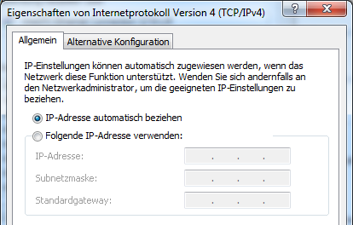

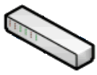
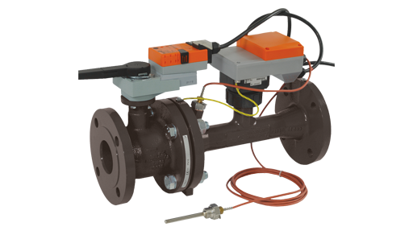
Network settings
Router
Static:
IP address and network parameters must be set manually. Must match the router settings (IP range, subnet mask, etc.).
Dynamic (DHCP):
The device acts as a DHCP client and requests an IP address and all network parameters from the DHCP server (e.g. router).
Switch
LAN device

Slide 21


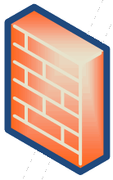
Internet Service Provider (ISP)
Service provider for connection to a WAN
Allocates IP addresses (DHCP server)
ISP

Slide 22






Internet
Networking of individual entities ISP and AS (autonomous system)
AS
AS
ISP
ISP
ISP
ISP
Notes:
The Internet is a complex network of networks. The Internet is a network of thousands of (partially) autonomous service providers. There is no central coordination for the management of connections, services and tariffs. Rather, the Internet consists of individual entities, typically Internet Service Providers (ISPs) or very large companies, which connect their networks to each other by arrangement and thus allow data exchange between them. Such a single entity is called an "autonomous system" (AS).

Slide 23
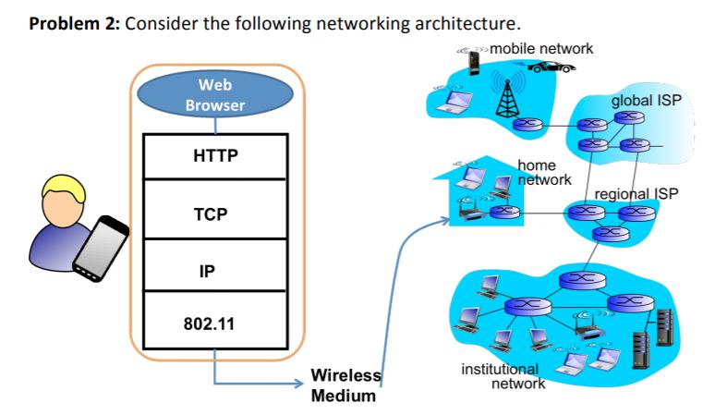
Internet

Slide 24
Öffentliche IP-Adresse (IPv4)
Check:
https://whatismyipaddress.com

Slide 25
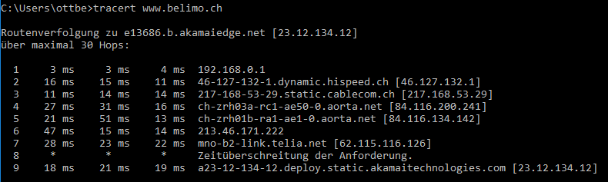
Check route to www.belimo.ch
-> tracert www.belimo.ch

Slide 26
Modem
Signal conversion
Ethernet <-> fibreglass
Notes:
The modem (a word formed from a modulator and a demodulator) is a communication device for exchanging digital signals over long transmission paths between two digital terminals.
Source: wikipedia

Slide 27

Modem
Signal conversion
Ethernet <-> Mobile network

Slide 28
Firewall
Serves security
Decides which packets are forwarded based on defined rules
Notes:
The firewall ensures security in the network because it is the central point that all data packets must pass through in the ideal case. It is a security system that protects a network or a single computer from unwanted access via data lines from outside, especially from the Internet. It controls all connections and blocks unauthorized access. Firewalls restrict communication between different networks or from/to individual systems based on defined firewall rules. Possible basic information with which the firewall rules can be set to deﬁniert includes the IP addresses of sender and recipient, port numbers and network protocols. Personal or desktop firewalls are simply software installed locally on the computer or laptop that protects a single system from unwanted access from the network. In the case of an external firewall beﬁndet, the firewall software does not install itself on the systems to be protected, but on a separate network device that separates the system to be protected from the public network, for example. As shown in the figure, this is usually located between the Internet router and the switch that connects the internal network devices.

Slide 29
Integrated Access Device (IAD)
Combination of various network components

Slide 30


DNS
Changes a domain into an IP address
e.g. www.belimo.ch <-> 23.50.104.191
ISP
Notes:
The Domain Name System (DNS) is one of the most important services in many IP-based networks. Its main task is to answer requests for name resolution.
The DNS works similar to a directory enquiry service. The user knows the domain (the name of a computer on the Internet that people can remember) - for example example example.org. He sends this as a request to the Internet. The domain is then converted there by the DNS into the corresponding IP address (the "connection number" in the Internet) - for example, an IP address of the form 192.0.2.42 and thus leads to the correct computer.

Slide 31
DNS - Local
ISP

Slide 32
Recap
Peer-Peer
Hub
Switch
Router
ISP
IAD
Useful links to recap at home:
https://www.youtube.com/watch?v=1z0ULvg_pW8&t=23s (7’18’’)

Slide 33
Network Models

Slide 34
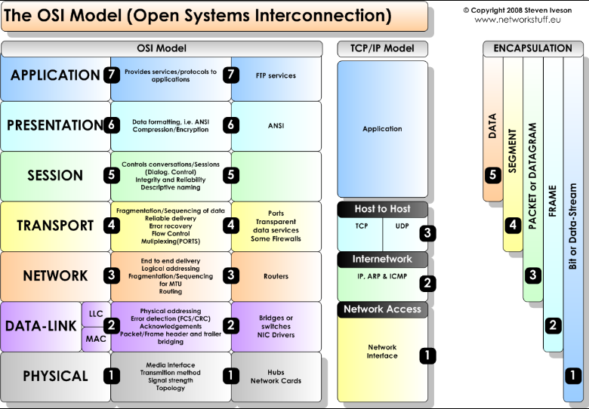
Network Models

Slide 35
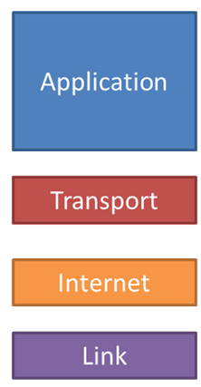
TCP/IP Model
Application layer – Application-specific
e.g. HTTP, FTP, SMTP, POP3, DNS, SSH, Telnet
Transport layer – Reliable transmission
e.g.TCP, UDP
Internet layer – Routing
e.g. IP (IPv4, IPv6), ICMP, IPX
Link layer – Data transmission technologies
e.g. Ethernet, WLAN, Coax, Fibre, ATM, FDDI, PPP, Token Ring
Notes:
The TCP/IP reference model was developed in 1970 by the Department of Defense (DoD) of the USA. It is also known as the DoD layer model. The communication tasks were divided into four consecutive layers. Each layer determines what it has to do. These requirements must be met by communication protocols. The concrete implementation is not predefined and can be different. Therefore, there are numerous protocols for each of the four layers.
The application layer includes all protocols that work together with application programs.
The transport layer enables end-to-end communication. The most important protocol of this layer is the Transmission Control Protocol (TCP), which establishes connections between two network participants for the reliable transmission of data streams. However, unreliable protocols such as the User Datagram Protocol (UDP) also belong in this layer.
The Internet layer is responsible for packet forwarding and routing. The task of this layer is to determine the next intermediate destination for a received packet and to forward the packet there. The core of this layer is the Internet Protocol (IP) version 4 or 6, which provides a packet delivery service. The Internet layer corresponds to the Network Layer of the ISO/OSI reference model.
The link layer is specified in the TCP/IP reference model, but does not contain protocols of the TCP/IP family. Rather, it is to be understood as a placeholder for various techniques for point-to-point data transmission. The Internet protocols were developed with the aim of interconnecting different subnets. Therefore, the host-to-net layer can be filled in using protocols such as Ethernet, FDDI, PPP (point-to-point connection) or 802.11 (WLAN). The link layer corresponds to the data link and physical layer of the ISO/OSI reference model.
Each layer adds additional information to a message as a header. Some protocols (e.g. Ethernet) add not only a header but also a trailer to the end of the message in the link layer. Headers (and trailers) are evaluated at the receiver on the same layer.

Slide 36
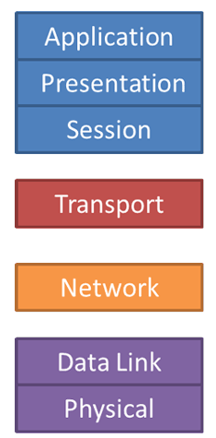
ISO OSI Model
Application / Presentation / Session layer – Data
z.B. HTTP, FTP, SMTP, POP3, DNS, SSH, Telnet
Transport layer – Segment
z.B.TCP, UDP
Network layer – Packet
z.B. IP (IPv4, IPv6), ICMP, IPX
Data Link layer –Frame
z.B. Ethernet, WLAN, ATM, FDDI, PPP, Token Ring
Physical layer – Bit
z.B. 1000BASE-T, Token Ring, ARCNET
Notes:
The application layer gives the applications access to the network. The actual application process lies above the layer and is not covered by the OSI model. Protocols on the application layer are for example HTTP, SMTP, Telnet, DNS, FTP, LDAP, NFS, NTP or SIP.
The presentation layer converts the system-dependent representation of the data (e.g. binary or integer) into an independent form and thus enables syntactically correct data exchange between different systems. Tasks such as data compression and encryption are also part of the presentation layer. If necessary, the Presentation Layer acts as a translator between different data formats by using a standardized syntax such as ASN.1 or XML.
The Session Layer provides process communication between systems. To resolve session breakdowns and similar problems, the Session Layer provides services for organized and synchronized data exchange.
The transport layer provides segmentation of data packets, congestion avoidance, optional error protection and error correction. The transport layer is the lowest layer that provides complete end-to-end communication between sender and receiver.
The network layer provides for the switching of connections in connection-oriented services and for the forwarding of data packets in connectionless services. In both cases, data transmission takes place over the entire communications network and includes routing between the network nodes.
The Data Link Layer ensures reliable, largely error-free transmission and regulates access to the transmission medium. This is achieved by dividing the bit data stream into blocks (frames) and adding packet numbers and checksums. Erroneous, falsified or lost blocks can be requested again by the receiver through acknowledgement and repetition mechanisms.
The physical layer provides mechanical, electrical and other functional tools to activate or deactivate physical connections, maintain them and transmit bits over them. These can be electrical signals, optical signals (optical waveguides, lasers), electromagnetic waves (wireless networks) or sound.

Slide 37
Components in ISO OSI Modell
Application / Presentation / Session / Transport layer – Gateway, Content-Switch, Proxy, Layer 4-7-Switch
Network layer –
Router, Layer-3-Switch
Data Link layer –
Bridge, Layer-2-Switch, Access Point
Physical layer –
network cable, Repeater, Hub

Slide 38
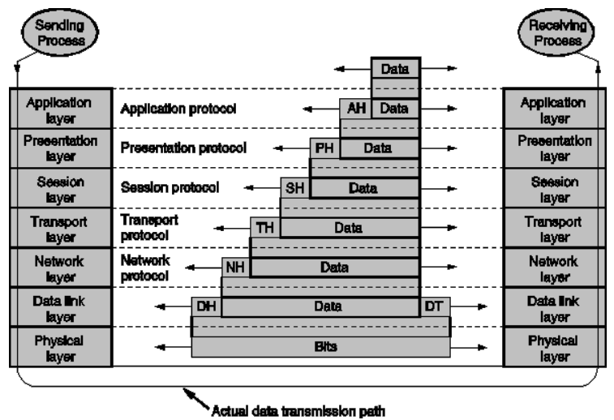
Data Transmission

Slide 39
Recap
Useful links to recap at home:
https://www.youtube.com/watch?v=HAVcXPI7oUY (47’02’’)

Slide 40


Slide 41
Thank you for your attention

